Slide 3
Input, output and FSM
South sensor | West sensor | Pedestrian sensor
PB9 | PB8 | PB7
Input:
Output:
Pedes Green (Walk) | Pedes Red (Don’t walk) | Red West | Yellow West | Green West | Red South | Yellow South | Green South
PA7 | PA6 | PA5 | PA4 | PA3 | PA2 | PA1 | PA0
Order: Walk -> West -> South

Slide 4
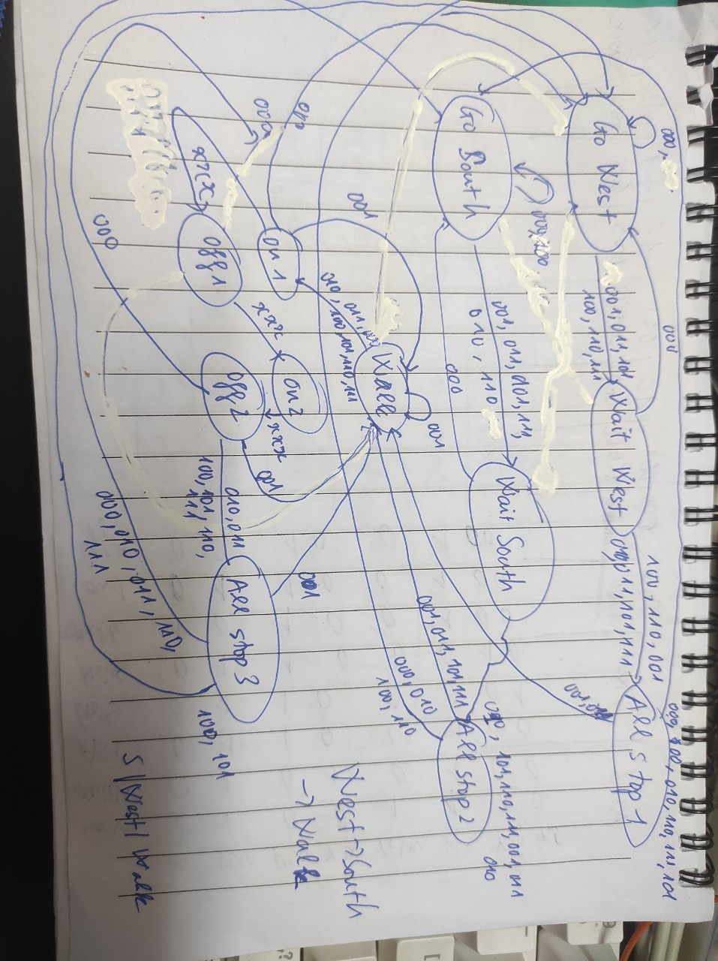

Slide 5
Table traffic
State | Output | Time | 000 | 001 | 010 | 011 | 100 | 101 | 110 | 111
Go West | 0x4C | 5000 | goW | waitW | goW | waitW | waitW | waitW | waitW | waitW
Wait West | 0x54 | 1000 | goW | as1 | as1 | as1 | as1 | as1 | as1 | as1
All stop 1 | 0x64 | 1000 | goS | walk | goS | walk | goS | goS | goS | goS
Go South | 0x61 | 5000 | goS | waitS | waitS | waitS | goS | waitS | waitS | waitS
Wait South | 0x62 | 1000 | goS | as2 | as2 | as2 | as2 | as2 | as2 | as2
All stop 2 | 0x64 | 1000 | goW | walk | goW | walk | goW | walk | goW | walk
Walk | 0xA4 | 5000 | on1 | walk | on1 | on1 | on1 | on1 | on1 | on1
On 1 | 0x62 | 500 | off1 | off1 | off1 | off1 | off1 | off1 | off1 | off1
Off 1 | 0x24 | 500 | on2 | on2 | on2 | on2 | on2 | on2 | on2 | on2
On2 | 0x64 | 500 | off2 | off2 | off2 | off2 | off2 | off2 | off2 | off2
Off2 | 0x24 | 500 | as3 | walk | as3 | as3 | as3 | as3 | as3 | as3
All stop 3 | 0x64 | 1000 | goW | walk | goW | goW | goS | goS | goW | goW

Slide 6
Struct State
struct State{
uint32_t output;
uint32_t time;
uint32_t next[8];
};

Slide 7
Procedure in main
Write output to port A
Set time for each state
Get input
Change state

Slide 13
THANK YOU !

